Slide 1
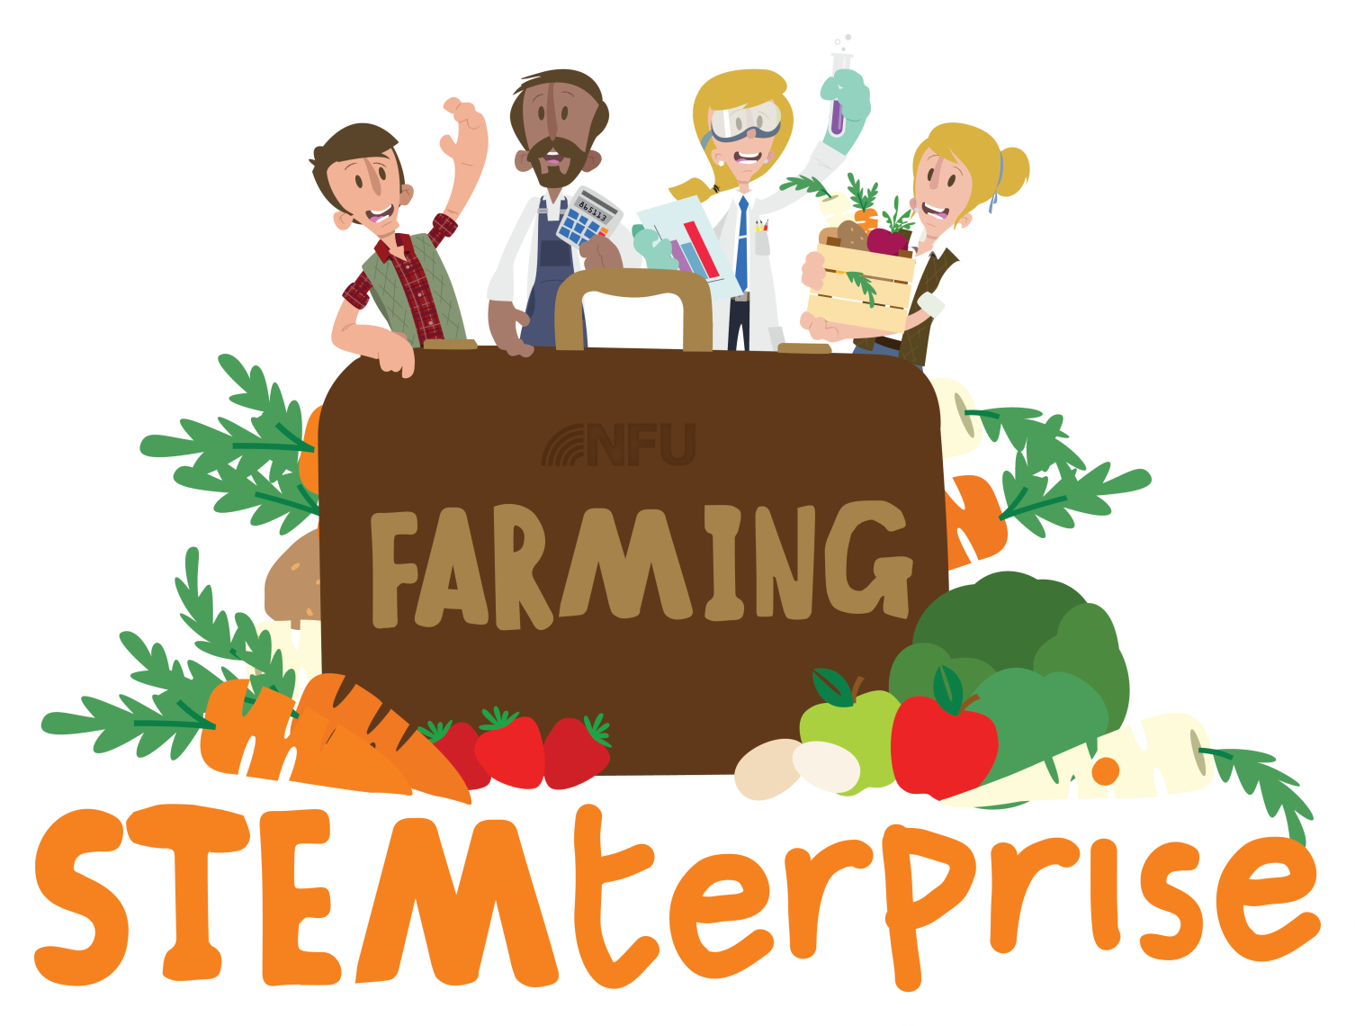
Stage 8: Making a food product

Slide 2
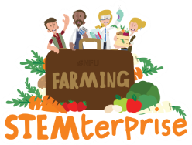
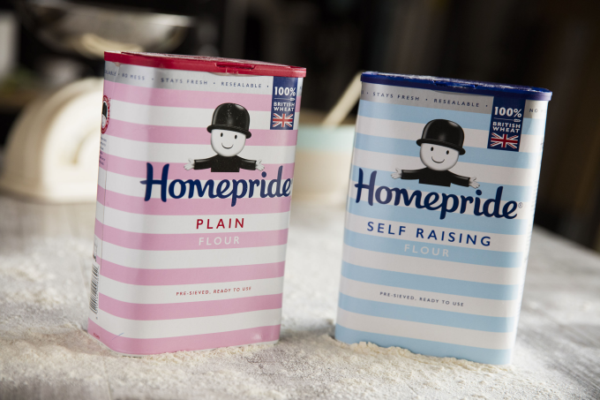
Learning Objective:
To produce a food product
Today, we will be making the flavoured
breads that you designed in Stage 3.
Before we begin, let’s learn about where
our ingredients have come from.
Flour is the main ingredient of bread.
Where does flour come from?
How is it made?
© Primary Food Tech 2018

Slide 3
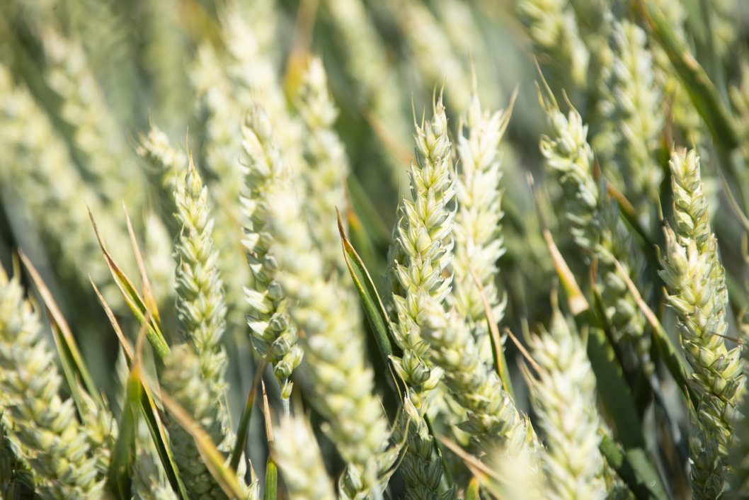
Wheat
Flour is made from wheat.
Wheat is a variety of grass.
It is known as a cereal grain.
© Primary Food Tech 2018

Slide 4
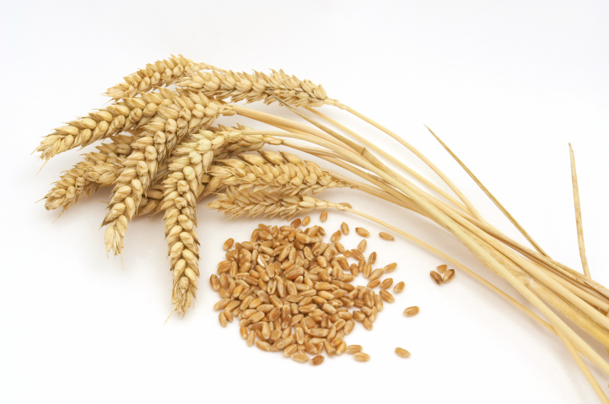
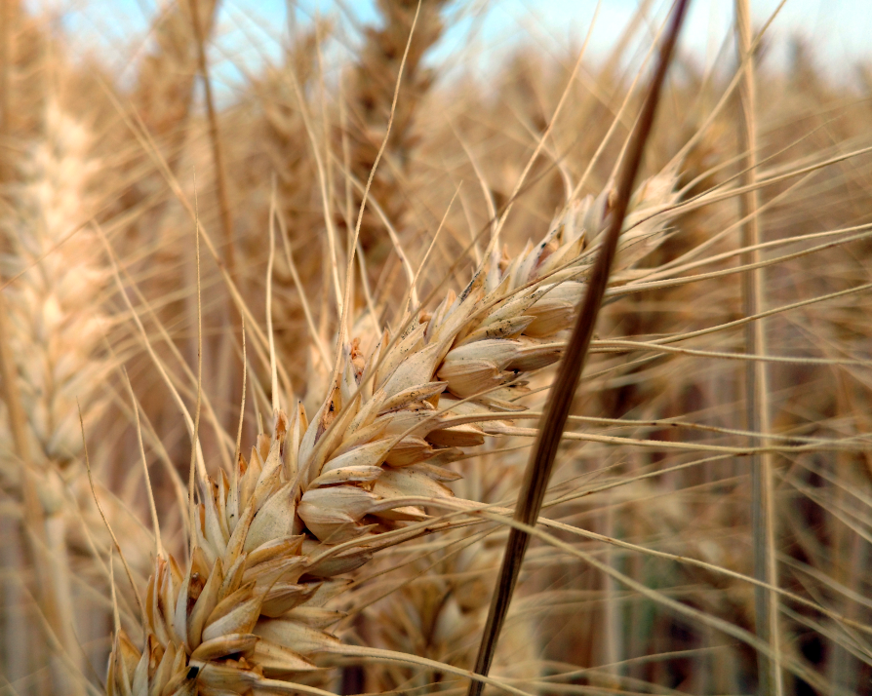
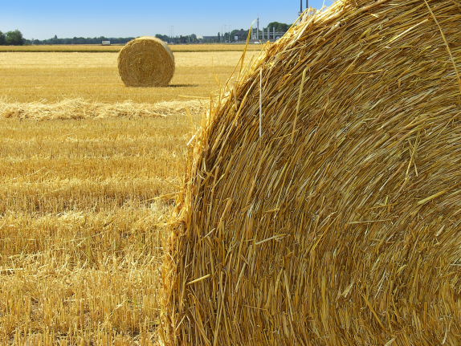
Wheat
We only use the grains for flour. The part of the plant where the grains are is called the ear. There are up to 50 grains in one plant.
The stalk of the plant is also used, but not for flour. This part is used to make straw, which animals will use as bedding.
© Primary Food Tech 2018

Slide 5
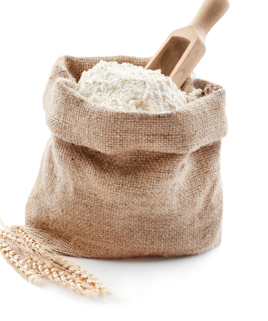
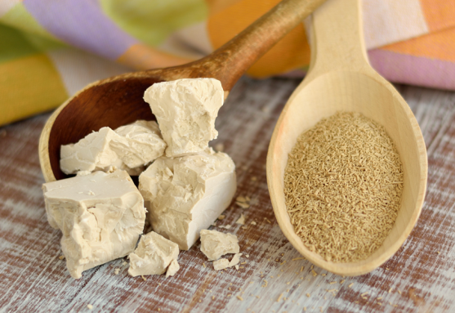
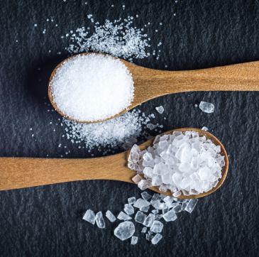
Bread
Bread is a staple food.
This means that the food is eaten frequently and makes up a large proportion of a person’s diet.
Flour is one of the main ingredients in bread. Without it, it would not form a dough.
Water or milk must be added to the flour in order to make the dough. The temperature makes a difference if you are using yeast.
Yeast feed on the sugars naturally found in flour. They then turn this sugar into carbon dioxide which makes the bread rise.
Salt is added to bread to enhance the flavours within the dough.
© Primary Food Tech 2018

Slide 6
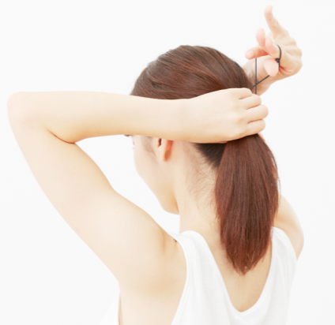
Let’s get ready to cook!
Wash your hands
Tie up long hair

Slide 7
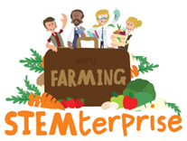
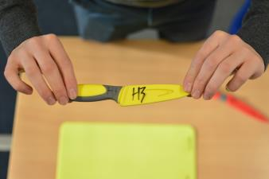
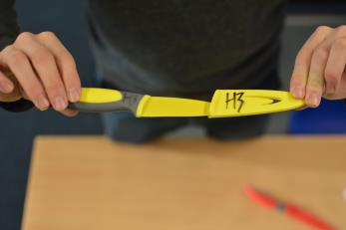
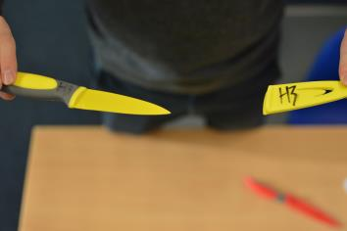
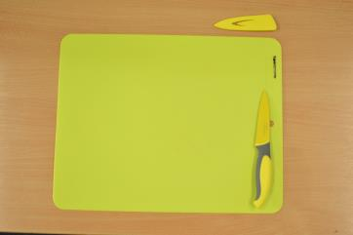
Knife safety
To remove the cover from the knife, pinch the end of the handle and the tip of the knife and face the knife away from you.
Gently, pull the cover away from the knife.
Make sure that you don’t swing your arms and put others in danger.
Your knife is now “active”. Make sure you keep your knife in the safety zone (your chopping board) and if it moves away from your chopping board, you are putting yourself and others in danger.
© Primary Food Tech 2018
Notes:
7

Slide 8
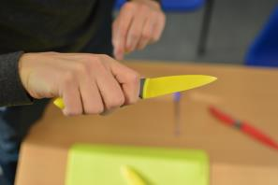
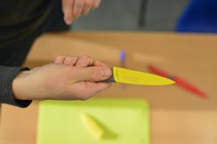
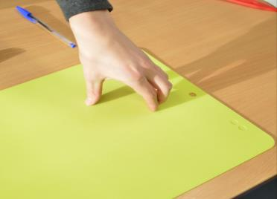
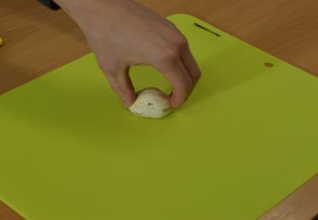
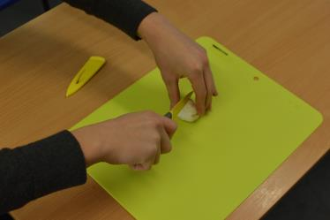
Bridge method
Make sure you have a firm hold on the knife.
Open your hand up. All your fingers need to be together with your thumb on the opposite side.
Grip either side of the food, making sure you have a firm hold.
Put the knife through the middle of your “bridge” to complete the cut.
© Primary Food Tech 2018
Notes:
8

Slide 9
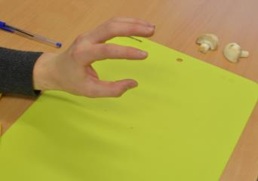
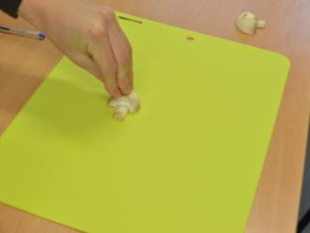
Claw method
Make sure you have a firm hold on the knife.
Hold your hand out and pretend you are “roaring” at someone with your hand.
Make sure your fingers are straight and your thumb is behind your fingers. Hold on tightly with the tips of you fingers.
Slice using the full length of the knife. Remember to keep those fingers straight.
© Primary Food Tech 2018
Notes:
9

Slide 10
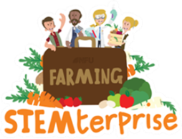
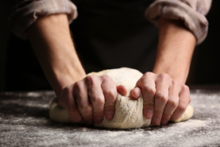
Kneading dough
When flour is mixed with water, it makes gluten. Kneading our dough develops the gluten and makes the dough nice and stretchy so we can shape it.
To knead your dough, use the heel of your hands to stretch and fold it over quickly.
Keep repeating this movement quickly until your dough is not sticky anymore.
Notes:
10

Slide 11
Evaluation
Taste your product and evaluate it using these ideas to help you. Score your product out of 5 and write a comment for each of the following features.
Feature | Score | Comment (give reasons for your scores)
Presentation
Texture
Taste
Value for money
What could you do next time to improve your product?
Notes:
11

